Slide 1
Searching and ranking similar clusters of polyhedra in inorganic crystal structures
Hans-Joachim Klein
Institut f. Informatik
Christian-Albrechts-Universität Kiel
Germany

Slide 2
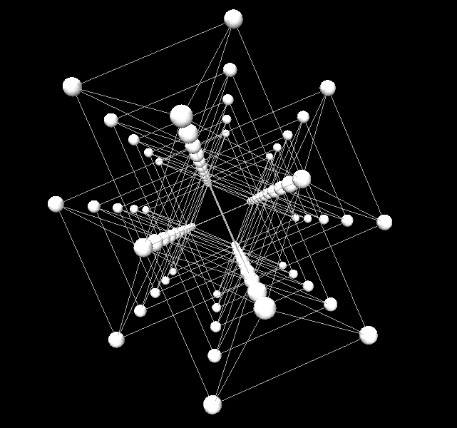
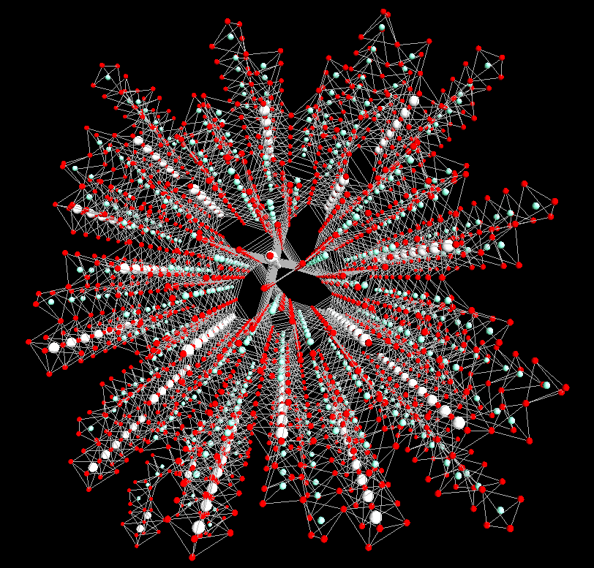
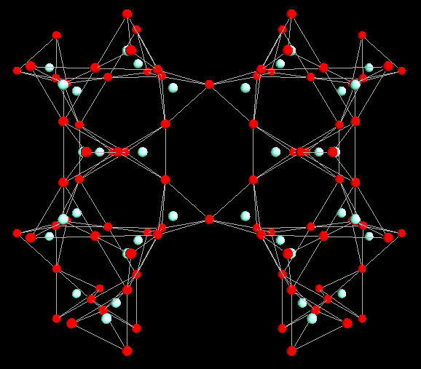

Slide 3
Definition:
A crystal is an anisotropic homogeneous body consisting of a three-dimensional periodic ordering of atoms, ions, or molecules.
direction-dependent physical properties
parallel directions:
same behaviour
Three-dimensional, periodic: basic units (atoms, ions, molecules),
repeating in all directions.
…..
…..

Slide 4
Definition:
A crystal is an anisotropic homogeneous body consisting of a three-dimensional periodic ordering of atoms, ions, or molecules.
direction-dependent physical properties
parallel directions:
same behaviour
Three-dimensional, periodic: basic units (atoms, ions, molecules),
repeating in all directions.
.
.
.
…..
…..
…..
…..
…..
…..
…..
…..
.
.
.

Slide 5
Definition:
A crystal is an anisotropic homogeneous body consisting of a three-dimensional periodic ordering of atoms, ions, or molecules.
direction-dependent physical properties
parallel directions:
same behaviour
Three-dimensional, periodic: basic units (atoms, ions, molecules),
repeating in all directions.
.
.
.
…..
…..
.
.
.

Slide 6
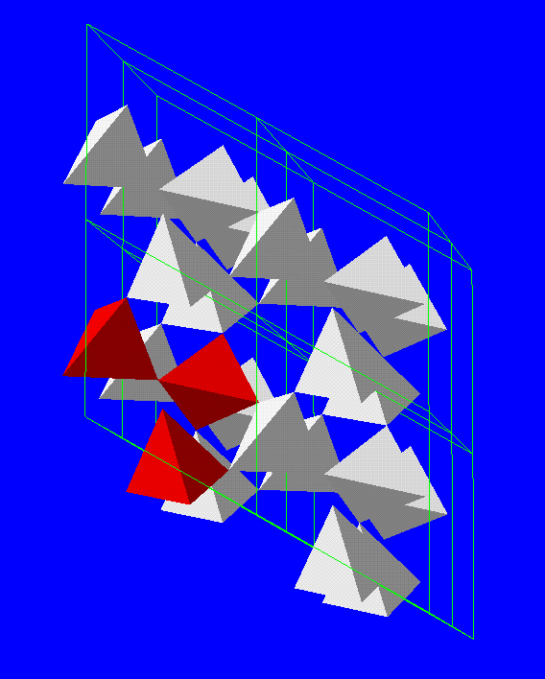
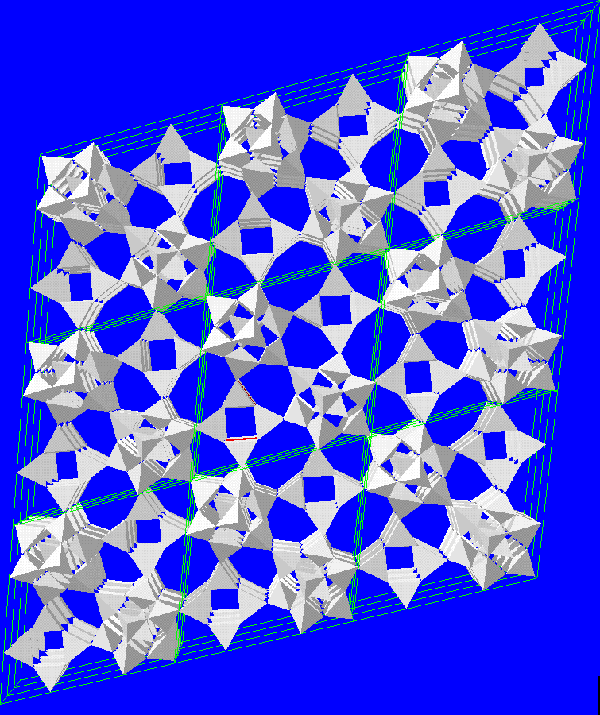
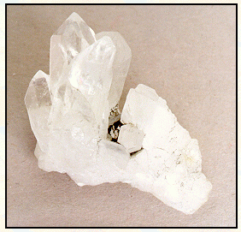
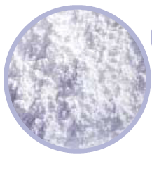
Abstraction by graphs
(the simple case)
ligands (O)
central atom
(Si)

Slide 8
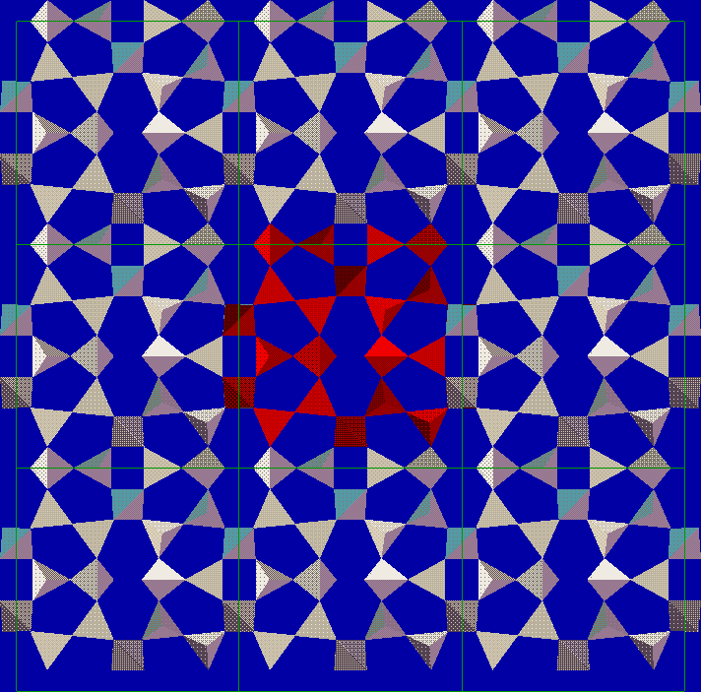
Periodicity
Y
.
.
.
X
(-1,-1)
(-1,0)
(-1,1)
....
....
(0,-1)
(0,0)
(0,1)
Unit cell
(1,-1)
(1,0)
(1,1)
.
.
.

Slide 9
Part of a layer in semenovite
Y
.
.
.
X
(-1,-1)
(-1,0)
(-1,1)
....
....
(0,-1)
(0,1)
(1,-1)
(1,0)
(1,1)
.
.
.

Slide 10
Y
X
(-1,-1)
(-1,0)
(-1,1)
+(-10)-
(0,-1)
(0,1)
(1,-1)
(1,0)
(1,1)

Slide 11
Labeled quotient graph / Direction-labeled graph
Chung/Hahn/Klee (1984), Goetzke/Klein (1987)
+(-10)-
-(-10)+
+(-10)-
-(-10)+
+(-10)-
≙
+(0-1)-
(10)
+(0-1)-
(-10)
+(0-1)-
+(0-1)-
+(-10)-

Slide 12
Some properties of direction-labeled graphs
n-colourability is decidable for n  2 but undecidable for n > 2.
Decomposition into fundamental chains (Liebau method) is NP-complete.
Isomorphism problem?

Slide 13
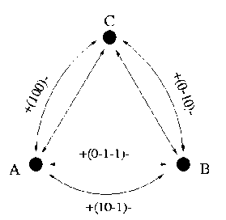
Dimensionality
l-1
(v₁,e₁,v₂,...,v_{l-1},e_{l-1},v_{l}) =_{df}  (e_{i})
(path direction)
i=1
DR(G_{dl}) =_{df} <{(c) | c Zyklus in G_{dl}}>  {(0,0,0)} (set of directions of repetition)
Dimension of a graph G_{dl}: Rank (dimension) of DR(G_{dl})
w_{i}
v_{i}
e
v_{j}
v
w_{j}
<{(w_{i}) + (e) - (w_{j}) | e  E, (e) = v_{i}, ➔(e) = v_{j}}>

Slide 14
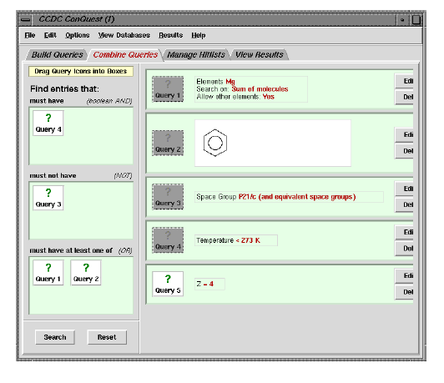
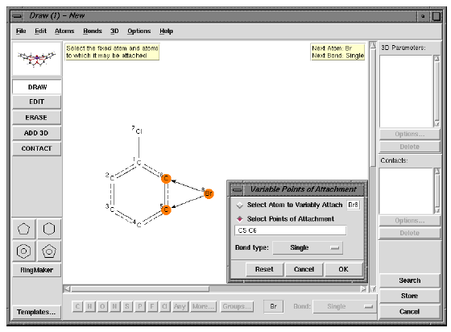
Organic databases:
Relatively small number of rigid substructures, mapping of 2D chemical structure
onto 3D molecular structure can be used for substructure searches.
Example: Cambridge Structural Database (organic and metal-organic compounds);
more than 500,000 single-crystal X-ray structures.
Search facilities: Structural search by drawing all or part of a molecule,
selection by providing chemical, bibliographic, .... information.

Slide 15
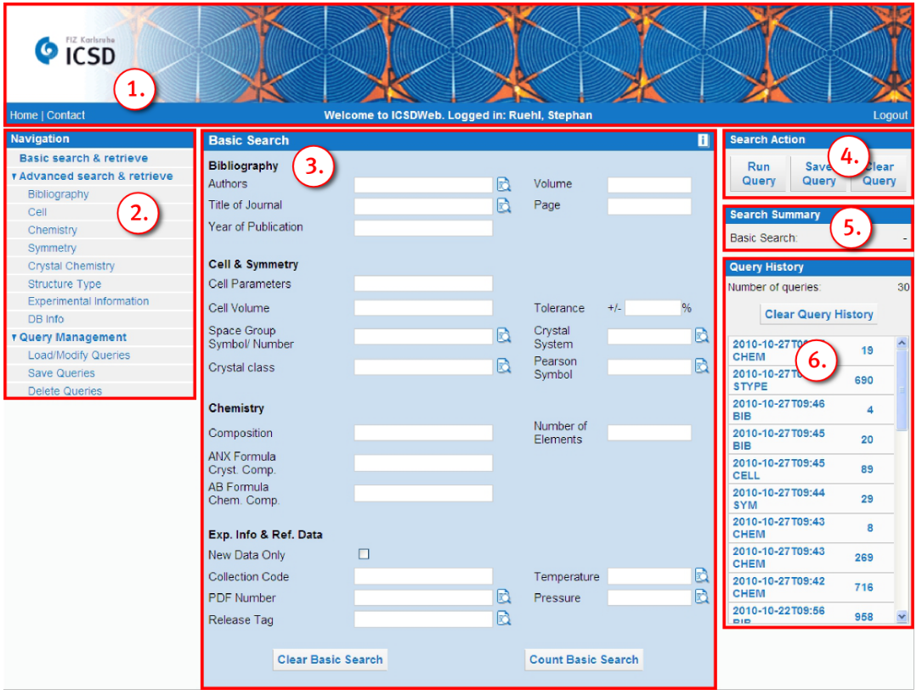
Inorganic databases:
Large variety of chemical elements and patterns ⇒
Problem to fix a suitable set of substructures for indexation.
Example: Inorganic Crystal Structure Database; more than 140,000 entries.
Search facilities: Selection in the categories
cell, chemistry, symmetry, crystal chemistry, structure type, bibliography.

Slide 16
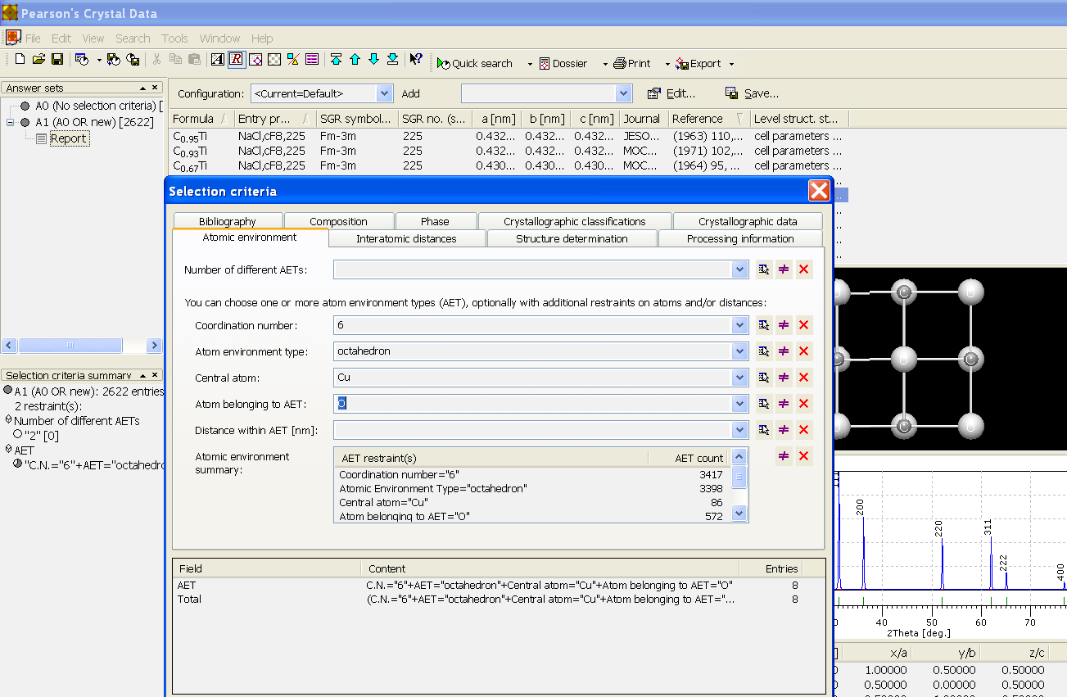
Inorganic databases:
Large variety of chemical elements and patterns ⇒
Problem to fix a suitable set of substructures for indexation.
Example: Pearson's Crystal Data; about 212,500 entries.
Search facilities: interatomic distances, phase information, chemical composition,
atomic environment (coordination number, atom coordination), ...

Slide 17
Part of the tetrahedral network of α-quartz
Common level of description: coordination polyhedra and their connections.

Slide 18
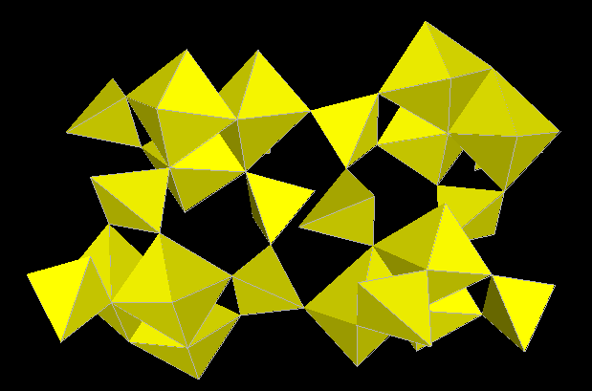
Vertex and edge sharing of octahedra and tetrahedra in zoisite

Slide 19
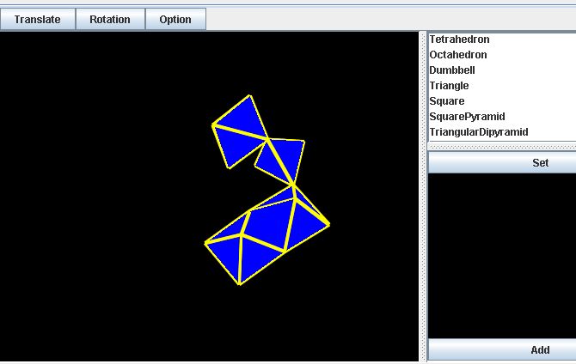
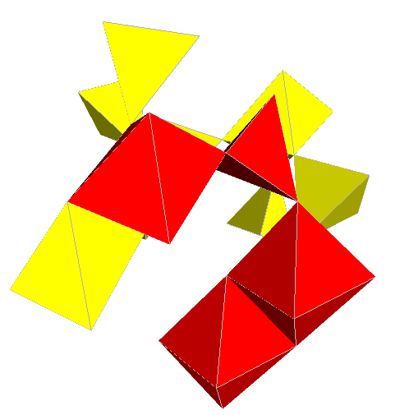
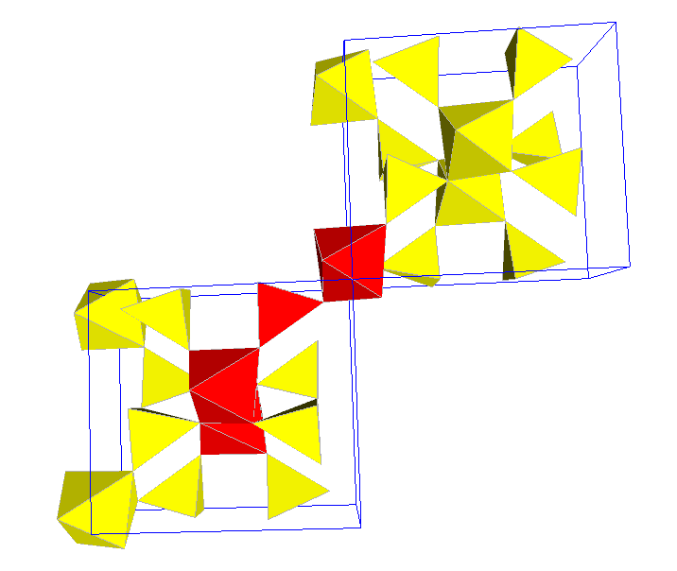
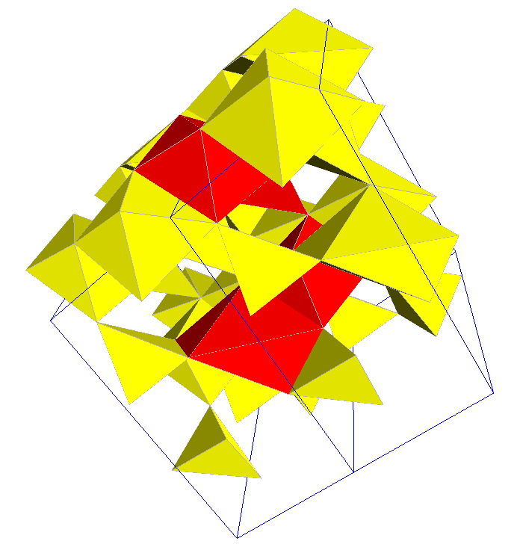
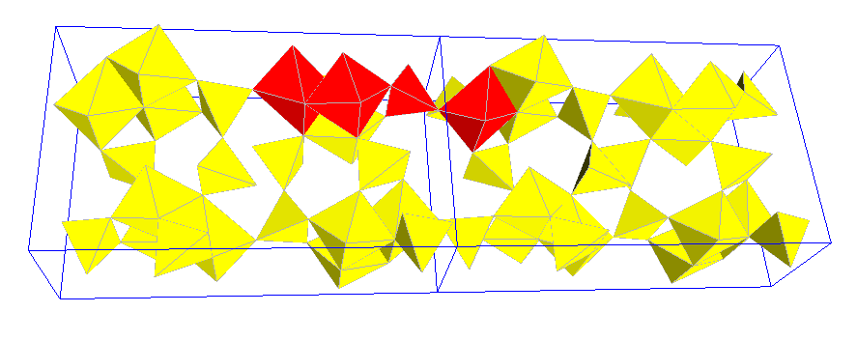
Given the structural pattern of a part of a (real or hypothetical) chemical compound.
The problem
Find all compounds in a given set of models with similar structural patterns.

Slide 20
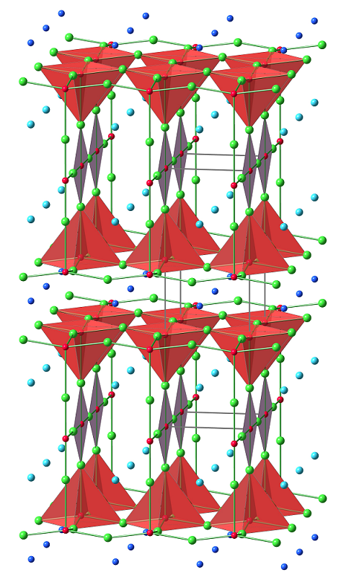
Combination of graphical and textual query parameters
Cations: Cu
Anions: O
Bonds: 'strong'
Pyramids: inclination > 55°
+
Notes:
addition of 'independent' polyhedra doesn't work

Slide 21
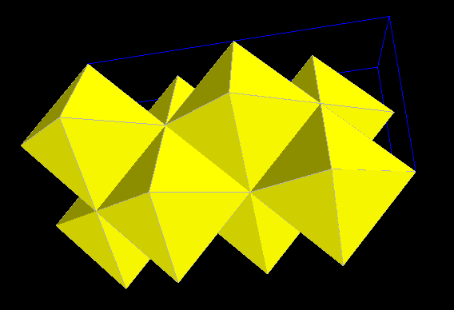
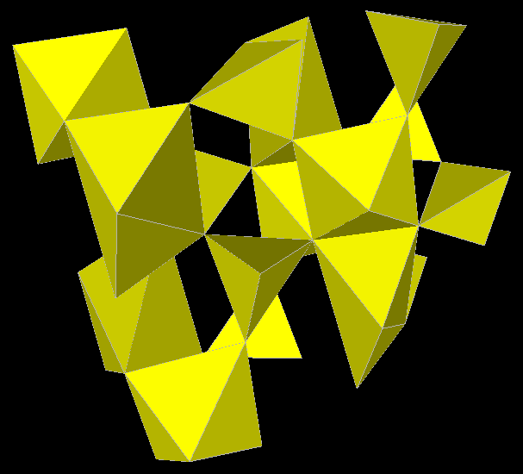
Difficulties
- Definition of coordination polyhedra (linear/quadratic gap, bond valence > 0.02 vu, ... ?).
Sodium chloride
Spodumene
.....
Na, Cl
Li, Al, Si, O
Regular convex polyhedra
as well as distorted polyhedra

Slide 22
Similar: The use of the term 'similar', ...., arises from the inherent difficulty in defining a priori limits on the similarity of geometrical configurations or physical/chemical characteristics.
(In: Terms that define different degrees of similarity between inorganic structures,
Nomenclature Commission, International Union of Crystallography)
Search for substructures should be flexible!
Two phases:
1. Determine topologically equivalent substructures.
2. Check possible embeddings for geometrical conformity.

Slide 23
Modelling of polyhedral networks
Problems to be solved:
Large variety of polyhedra (regular or distorted).
Three kinds of connections between polyhedra (vertex, edge, or face).
Infinite periodic structures.
Topological view of convex polyhedra:
Three-connected planar graphs (Theorem of Steinitz).
Equivalence of polyhedra: Isomorphic topological views (allowing distortions).
and
are topologically equivalent:

Slide 24
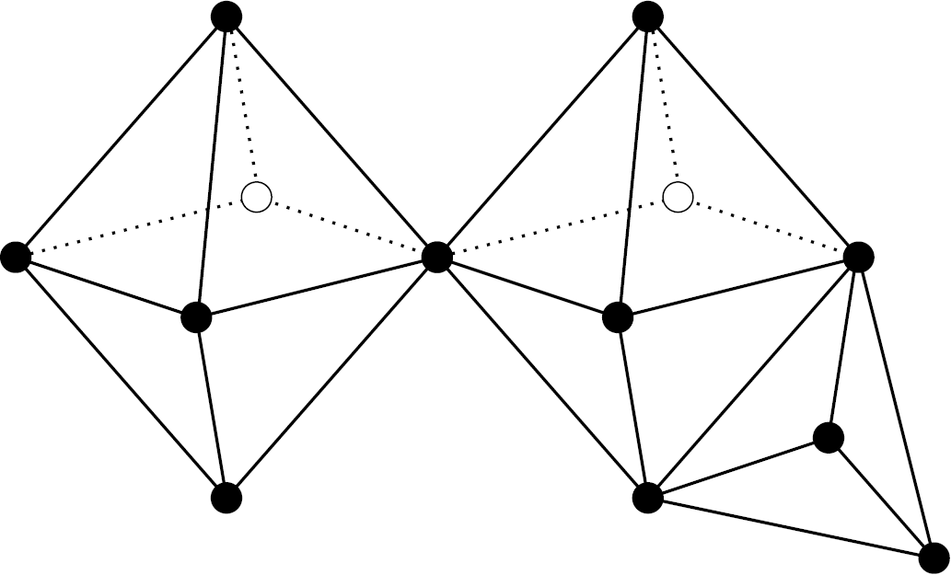
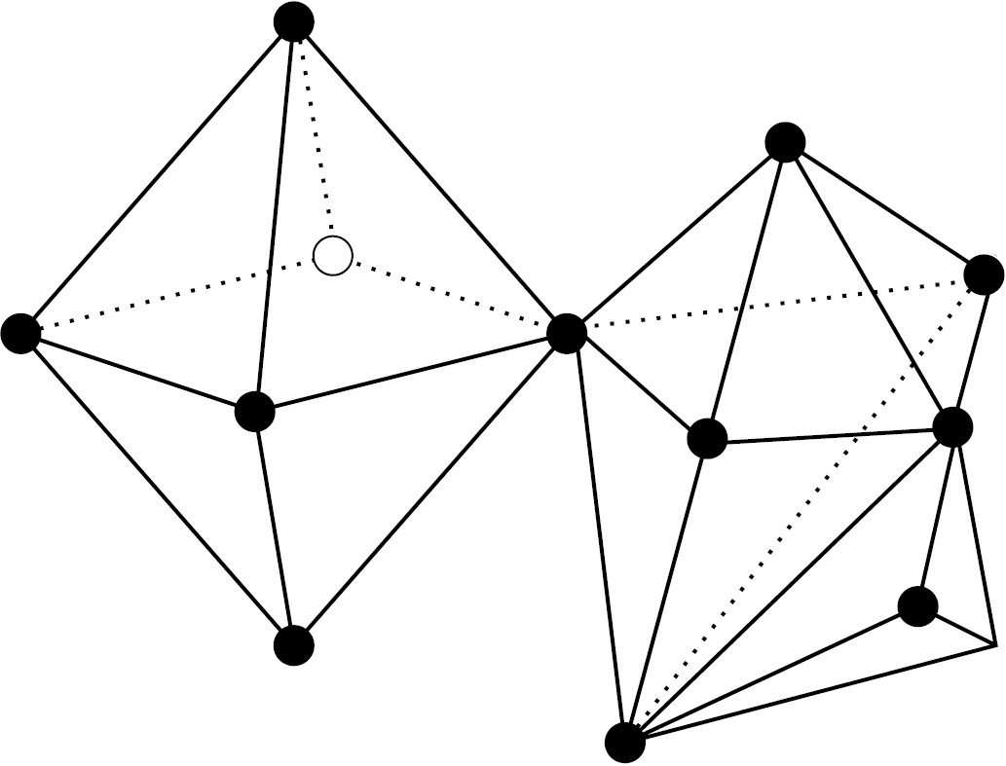
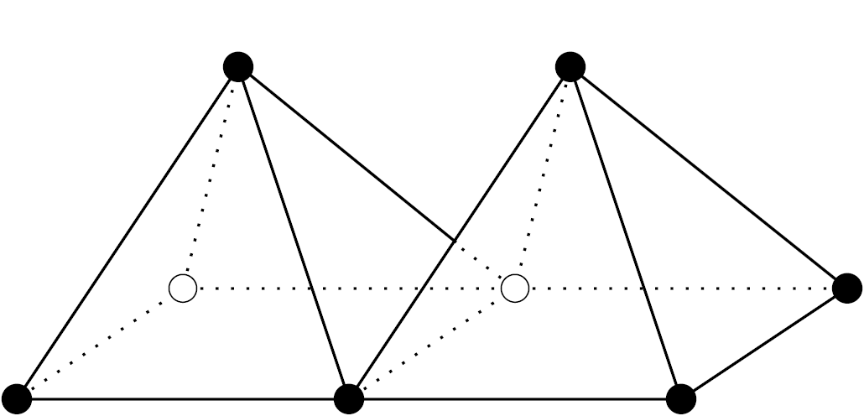
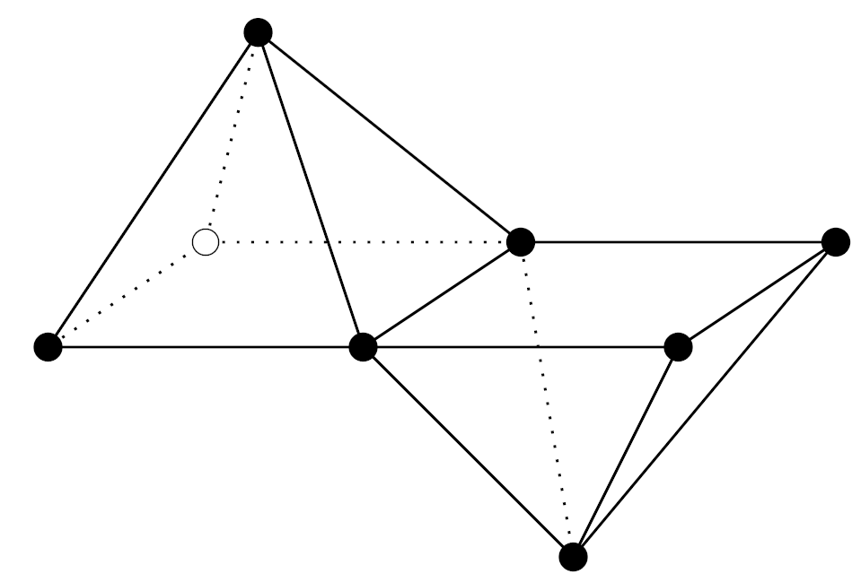
Clusters of polyhedra: Connected units of polyhedra.
Equivalence of clusters? We are dealing with experimental data!
Transformation should be possible without breaking connections between polyhedra (but allowing distortions).
Example:
Equivalent:
Not equivalent:

Slide 25
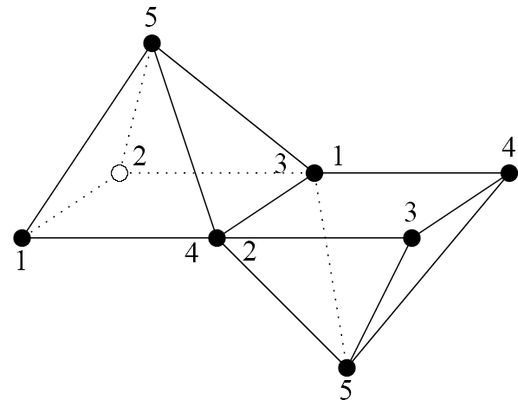
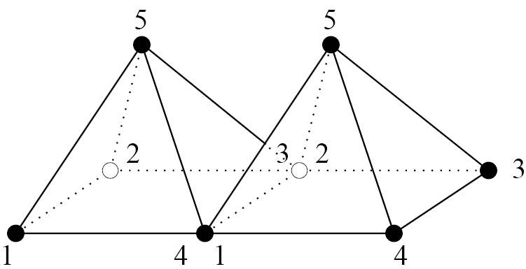
Graph representation
Ordered face representation
1432
154
125
235
345
1432
154
125
235
345
1432
154
125
235
345
1432
154
125
235
345
(4,1)(3,2)
(4,2)(3,1)

Slide 26
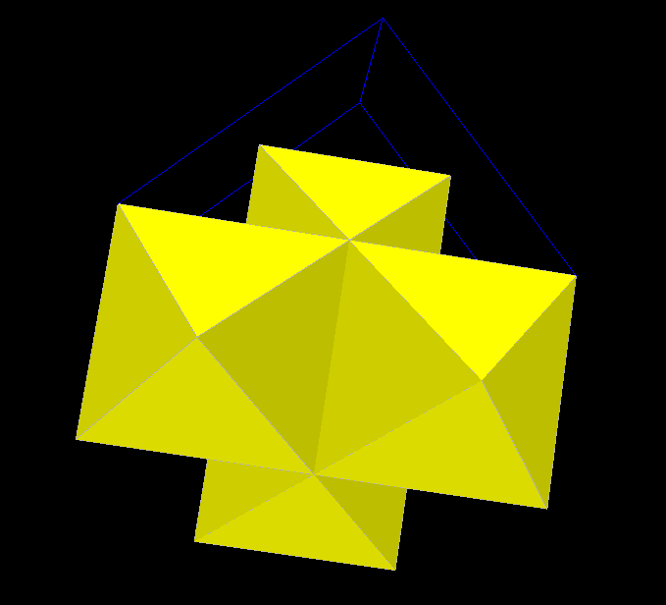
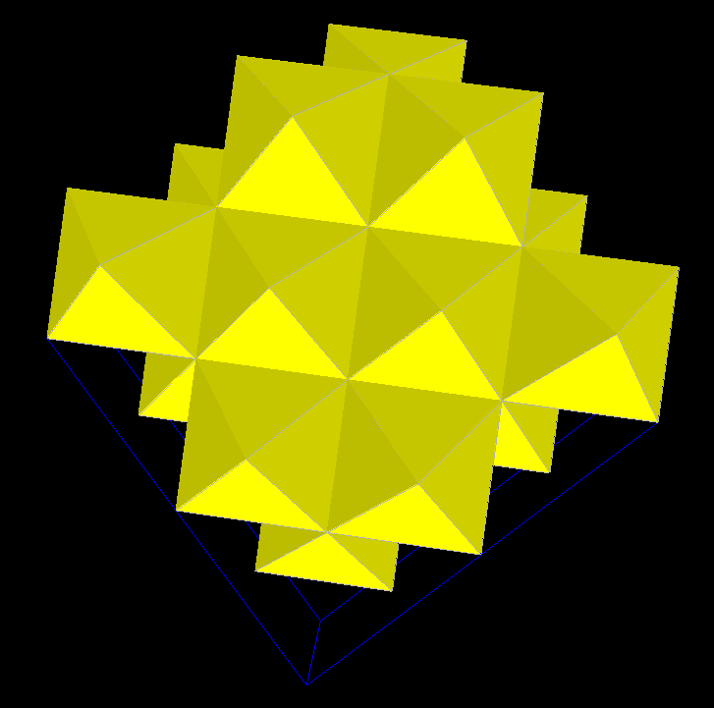
Sodium chloride
145
152
123
134
465
256
263
364
Polyhedra graph:
Unit cell
(4,1)(6,2)
(1,3)(5,6)
(6,1) +(0,-1,0)-
(5,3) -(0,0,1)+
145
152
123
134
465
256
263
364
145
152
123
134
465
256
263
364
(5,2)(4,3)
x
z
(2,3)(5,4) -(100)+
z
2
5
3
4
145
152
123
134
465
256
263
364
Neighbourhood
(5,1)(6,2)
(1,2)(4,6)

Slide 27
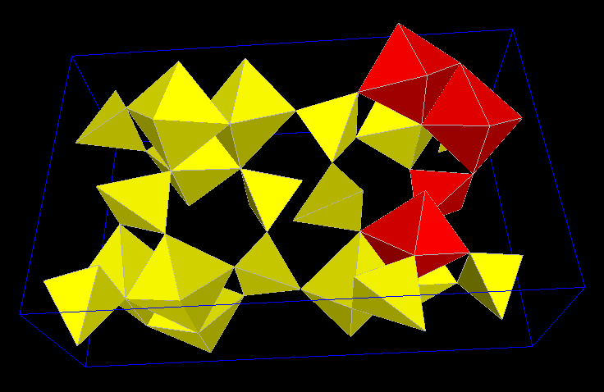
Topological search
Subgraph isomorphism problem: computationally hard.
Preprocessing of model structures in the database.
Indexation of polyhedra graphs
Proceeding
Consider paths up to some fixed limit length.
Extract information relevant for topological search.
Organize this information as an index.

Slide 28
Retrieval of substructures

Slide 29
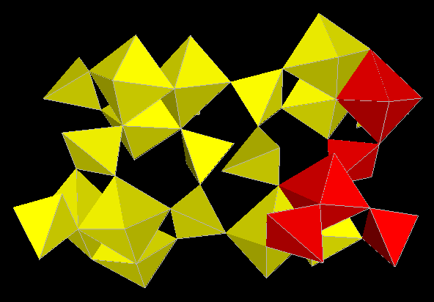
Substructure marked for search

Slide 30
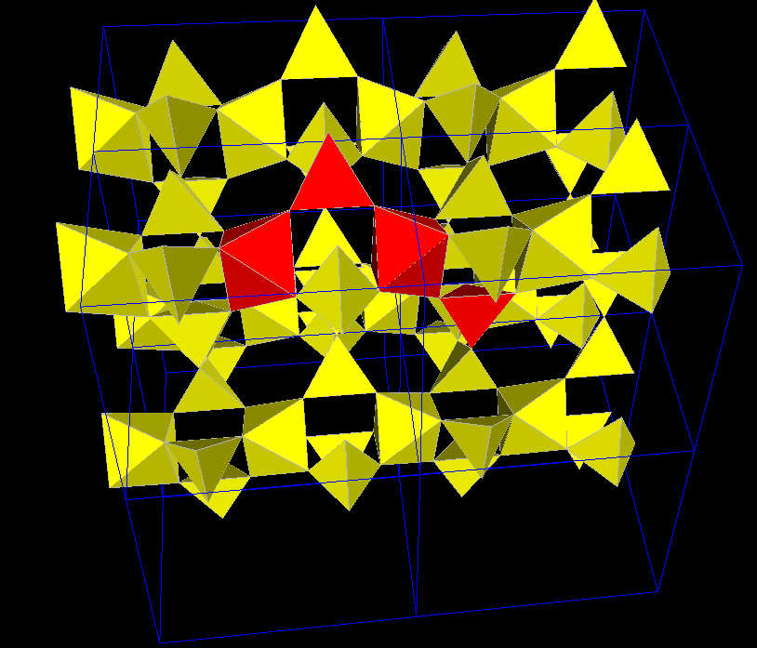
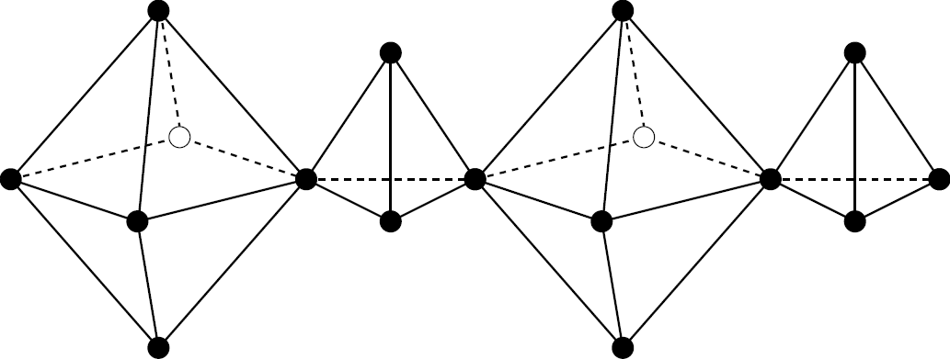
topological information
cis:
Search chain
trans:
Polyhedron Immediate neighbours Connection
octahedron 6 1
tetrahedron 4 1, cis
octahedron 6 1, trans
tetrahedron 4 -
max, extendable, no precycle
coding

Slide 31
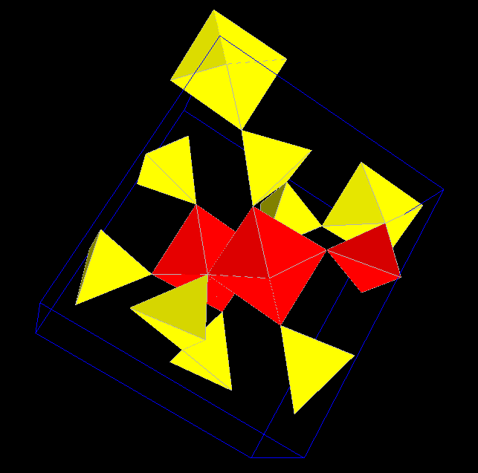
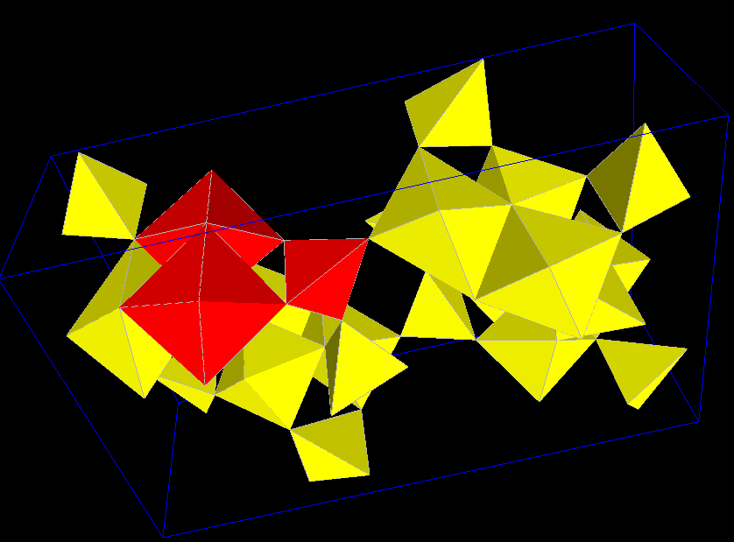
Zoisite
Acmite
Precycle
jump

Slide 32
Organization of search chains
4
1
Ordered prefix-tree
3
104, 1
4
306, (not max, extendable, precycle)
3
p-node: Polyhedron identifier, kind of connection to successor or
general information on search chain (in case of last polyhedron).
Exact match
l-node: Number of immediate neighbours.
Matching: 
i-node: Ordered list of identifiers of model graphs.

Slide 33
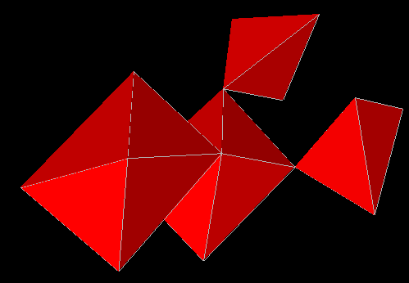
Determination of isomorphic substructures
Compute search chains for the input structure.
Collect candidates by inspecting the prefix tree.
Determine an edge covering of the input structure.
For every candidate model graph compute instances for all chains from this covering.
Try to find a subset of instances such that the corresponding subgraph is isomorphic to the input structure up to vertex labels.

Slide 34
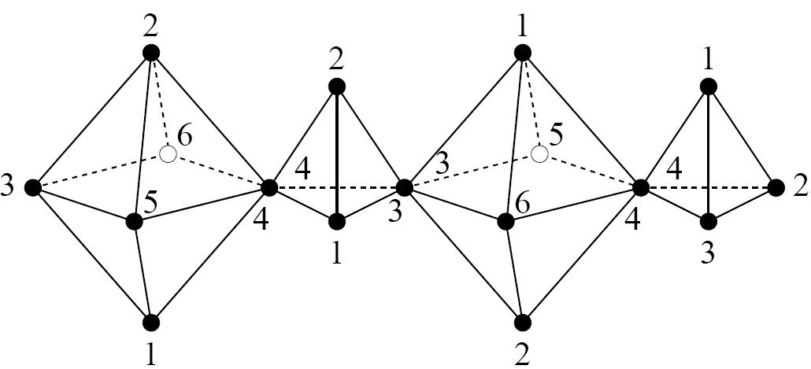
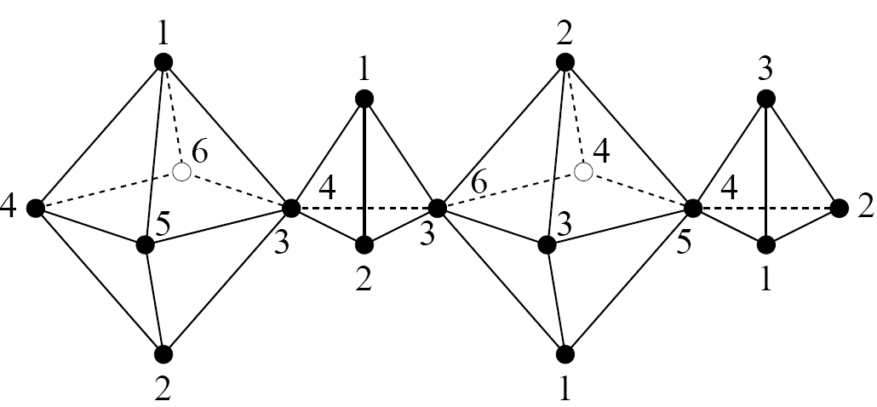
Sketch of search:
Compute annotated paths for the input structure.
Use the index to determine candidate model structures.
Try to locate substructures in these model structures having the same
path cover as the input structure.
Check for permutations of polyhedra vertices to get isomorphic graphs.

Slide 35
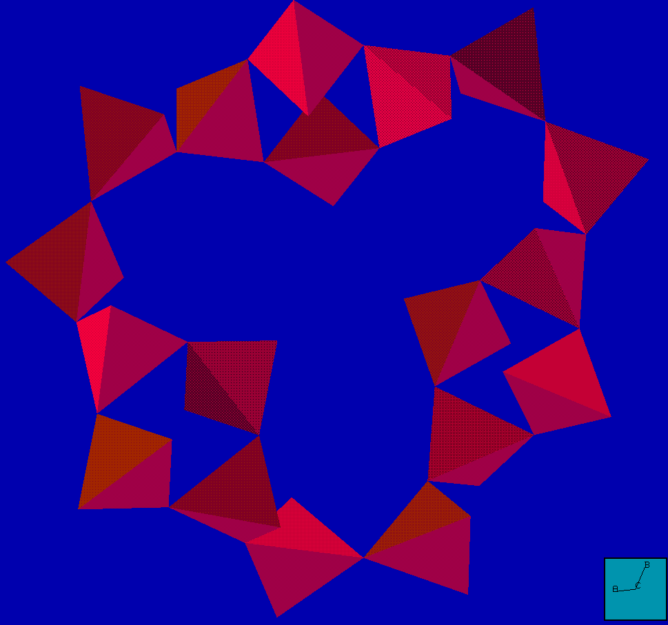

Answer complexity
Number of isomorphic substructures in a single model structure?
Leifite
44 not symmetrically equivalent 15-membered rings in leifite.

Slide 36
Embedding

Slide 37
Permutations
1234
1465
3864
2783
1572
5687
1234
1465
3864
2783
1572
5687

Slide 38
Geometric similarity
Two levels:
1. Polyhedra
2. Relative positioning of polyhedra.
hinge

Slide 39
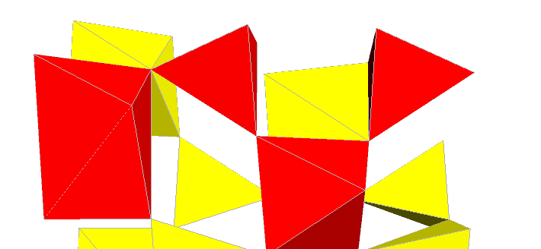
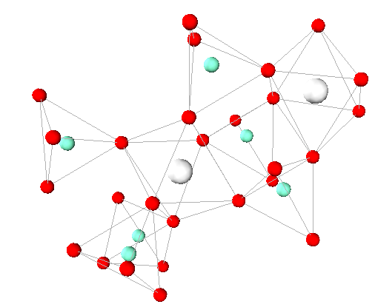
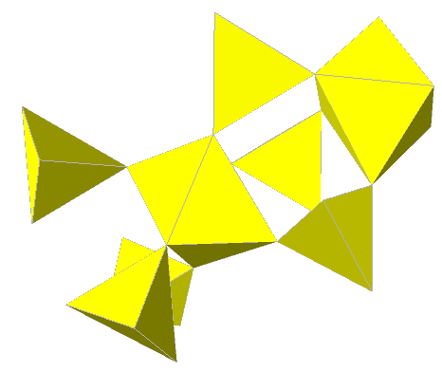
To solve: The problem of absolute orientation.

Slide 40
C_{S} : {c₁,...,c_{n}}, C_{S'} : {c₁',...,c_{n}'}
sets of the coordinates of the central atoms of isomorphic structures S and S', resp.
Consider C_{S} and C_{S'} as rigid subsets of ℝ³.
Look for a motion T in the group of proper Euclidean motions solving the following least-squares problem:
n
U := Σ ∥c_{i}' – T(c_{i})∥² = min
i=1
²
Measuring similarity:
√ U
(Root Mean Square)
ε :=
n
Implementation: Closed-form solution using unit quaternions
(algorithm of B.K.P. Horn, 1987).

Slide 41
The result
Given: A structural pattern of a part of a chemical compound (real or hypothetical) and
a database with structure data (including polyhedra graphs) and index.
Answer: Compounds with isomorphic structural patterns and their RMS values.
Jadeite: 0.680581 Zoisite: 0.789256 Spodumene: 0.110646

Slide 42
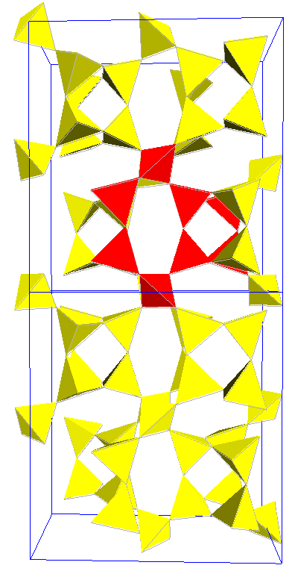
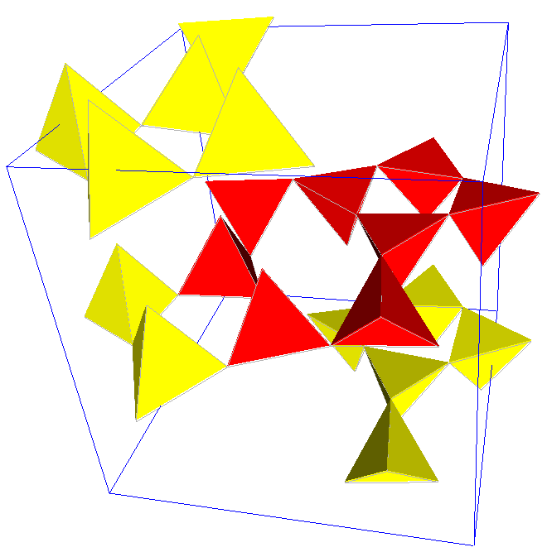
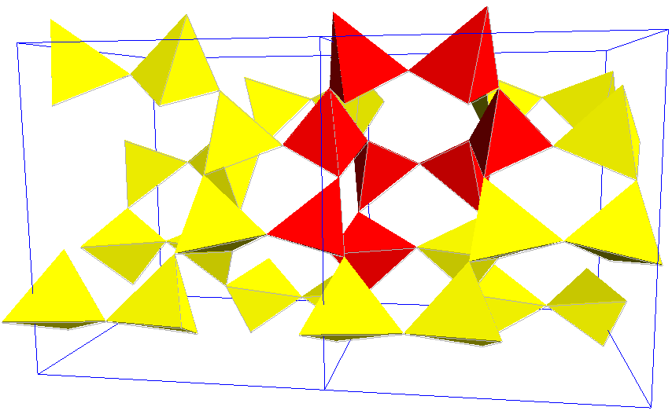
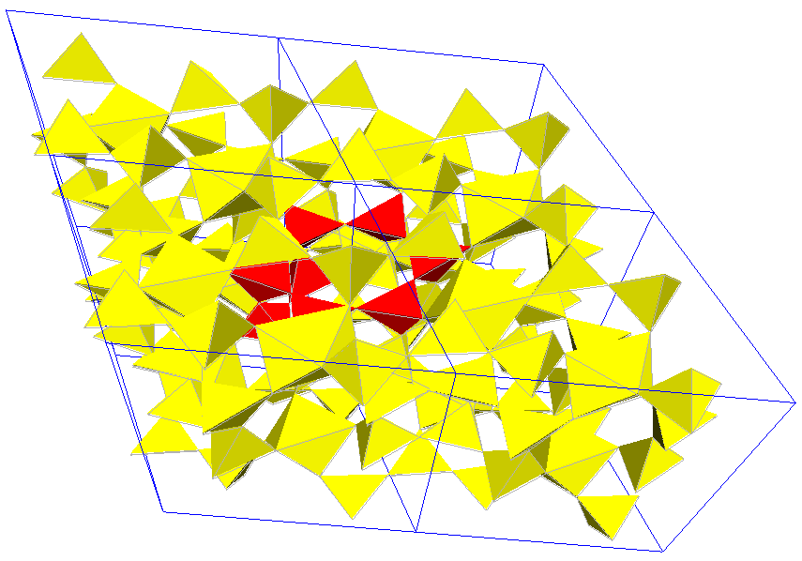
Epididymite:
RMS 0.162449
Search structure in aminoffite
Paracelsian:
RMS 0.485688
Merrihueite:
RMS 0.711812

Slide 43
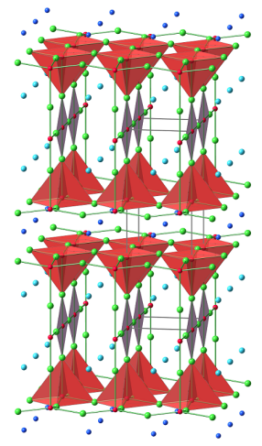
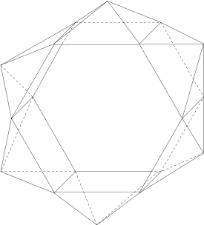
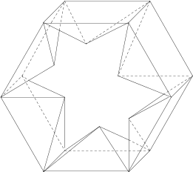
Future work
Searching: Improve the embedding algorithm (permutations, symmetries).
Allow more than one connected component:
Ranking: Include measures of distortion in the description of
coordination polyhedra.
General: Investigate the realization space of polyhedra graphs
(subspace of generalized hinge motions, generators,...?).
hinge motion with
interpenetration

